Slide 1



OECD ECONOMIC SURVEY OF
GREECE 2020
Recovering from COVID-19, boosting productivity, improving inclusiveness
22 July 2020, Athens and Paris
www.oecd.org/economy/greece-economic-snapshot/
@OECDeconomy
@OECD

Slide 2
Key messages
Responding to the COVID-19 shock
Tackling long-standing challenges to improve public finances, productivity, job creation and well-being
Extend exceptional support for households and firms as needed without hampering reallocation of activity
Pursue plans to accelerate the digitalisation of the public administration to increase its efficiency and service quality
Boost job-search and training policies to improve workforce skills and better match job-seekers with firms
Enhance access to family care to boost opportunities
End fossil fuel subsides to help clean urban air and reduce health risks
Allow small firms to grow and facilitate firms’ restructuring

Slide 3
Greece was recovering from the great financial crisis before COVID-19 hit
Real GDP per capita
Thousand USD, PPP
Source: OECD Economic Outlook database.

Slide 4
Greece responded swiftly to COVID-19, limiting the death toll
OECD COVID-19 Containment
Policy Tracker indicator
Scale 0-1 (most stringent)
COVID-19 deaths per million population
Source: OECD country policy tracker https://www.oecd.org/coronavirus/country-policy-tracker/; John Hopkins University Center for System Sciences and Engineering, https://github.com/CSSEGISandData/COVID-19.

Slide 5
The shock has set back the recovery in confidence
Consumer and business confidence
% balance of positive versus negative answers, seasonally adjusted
Source: Eurostat

Slide 6
Tourism is highly exposed to COVID-19 and is important for Greece’s exports and incomes
International tourism receipts
% of total exports, 2018
Source: OECD Economic Outlook databases; World Bank World Development Indicators database; and OECD calculations.

Slide 7
The COVID-19 shock interrupts the recovery and creates exceptional uncertainty
Real GDP
Index, 2019Q4 = 100
The “single-hit” scenario assumes that the pandemic is brought under control before the summer of 2020; the “double-hit” scenario assumes a second wave of contagion and lockdown measures late in 2020.
Source: OECD Economic Outlook database.

Slide 8
This is a marathon not a sprint:
we are only in phase 2 of the pandemic crisis
Potential reversion if the number of Covid-19 cases increases above threshold levels
Phase 2:
Co-existing with Covid-19
Phase 3: Vaccine and/or treatment
Phase 1:
Containment
Flattening the virus curve
Restarting activity while avoiding a second wave of Covid-19
Robust, sustainable and inclusive recovery
Policy agility and flexibility
© OECD |
3

Slide 9
Responding to the COVID-19 shock

Slide 10
Targeting income support to reduce the risk of poverty
Reduction in the poverty rate through social transfers
2019, % points, population under 65
Note: Population at risk of poverty, 50% of median income poverty line
Source: Eurostat and OECD calculations

Slide 11
The shock sets back employment, adding urgency to revamping training and job-search programmes
Spending per unemployed
in active labour market programmes
% GDP per capita
Employment rates
% of working age population, s.a.
Projections are shaded. The “single-hit” scenario is shown with a dashed line and assumes that the pandemic is brought under control before the summer of 2020; the “double-hit” scenario is shown with a dotted line assumes a second wave of contagion and lockdown measures late in 2020.
Source: OECD Main Economic Indicators and OECD calculations based on Economic Outlook 107.

Slide 12
COVID-19 heightens the need for access to childhood education and family care
Enrollment rates in early childhood education, age 3
Care personnel per 1000 population
Source: OECD Health Statistics and Education Statistics databases.

Slide 13
Improving schools’ performance would help lift basic skills
Mean PISA score, 15-year-old students
Share of adults with low basic skills
Source: OECD PISA and PIAAC databases.

Slide 14
Boosting digital skills opens opportunities in new types of work
Share of individuals scoring well in problem-solving skills in
technology-rich environments
Source: OECD (2019), How's Life in the Digital Age?

Slide 15
Returning banks to health to finance the recovery and provide liquidity
Non-performing loans
% of all loans
Non-performing loans net of provisions to total regulatory capital
* 2019Q4 or latest available quarter
Source: Bank of Greece; European Banking Authority (2020),"Risk Dashboard, Data as of Q4 2019" and IMF (2020), IMF Financial Soundness Indicators database.

Slide 16
Boosting public investment to upgrade infrastructure
Quality of infrastructure
Scale 1-7 (best)
10th percentile
Source: World Economic Forum (2019); OECD R&D Tax Incentive Indicators

Slide 17
Main recommendations to respond to the COVID-19 shock: Supporting people
Extend exceptional fiscal support measures, and the new short-time work scheme, as needed, while ensuring they do not hinder the reallocation of resources towards firms and sectors with better growth prospects.
Increase Guaranteed Minimum Income transfers, taper them more gradually as beneficiaries’ earn more and introduce in-work benefits for low-wage workers.
Employ more specialised counsellors and profiling tools in public employment services to significantly improve job search and training support, linking them better with private job-search agencies.
Roll-out compulsory pre-school for 4 year olds and expand access for younger children.
Boost policies to support families, prioritising expanded access to quality care for children and the elderly.
Progressively move the teacher workforce onto longer-term contracts that support and reward performance and avoid the rigidity of the existing permanent contracts.
Encourage tertiary education institutions to develop courses adapted to mature-age students’ professional needs and practical circumstances.
Improve quality assessment and certification of adult learning courses.

Slide 18
Main recommendations to respond to the COVID-19 shock: Investment for the recovery
Swiftly implement the Hercules scheme to dispose of non-performing loans from banks’ balance sheets.
Urgently design and implement a strategy to address the deferred tax credits and the bad loans that will remain on banks’ balance sheets.
Boost public investment to support growth and environmental sustainability, including in public transport, innovation and waste management, based on cost-benefit analysis.
Ensure pension spending does not crowd out on other, better-targeted, social programmes and public investment.

Slide 19
The COVID-19 shock amplifies
Greece’s long-term challenges: reforms are key to tackling them

Slide 20
A broad reform programme would ensure a stronger, sustained recovery
Trend real GDP per capita
2010 prices
Source: OECD calculations.

Slide 21
Reforms to strengthen the recovery through higher employment, investment and productivity
% difference in level of GDP, relative to 2019 policies
 | Policy goals | Policy actions | 2025 | 2030 | 2040 | 2050
1 | Policies to support employment and inclusiveness | Support employment by reducing the labour tax wedge. Strengthen social protection policies to reduce inequality. Support inclusive employment opportunities by raising in-kind family spending. | 0.8 | 3.0 | 5.2 | 6.1
2 | Policies to improve the investment climate | Improving judicial and public administration efficiency continues to raise 'rule of law'. Corporate income tax rates are lowered to 24% from 2022. | 0.0 | 0.1 | 1.2 | 4.5
3 | Boost investment in infrastructure, knowledge and human capital | Increase public investment spending to 4% of GDP by 2030. Use public incentives to boost R&D spending. Raise the quality of schooling, while expanding adults' participation in adult skill and training. Boost spending on active labour market policies. | 0.4 | 2.1 | 6.5 | 11.8
4 | Recommended reform package | Introduce all of above reforms. | 1.2 | 5.2 | 13.4 | 24.2
5 | Recommended reform package with faster population growth | Introduce all of above reforms and assume faster population growth. | 1.7 | 7.1 | 19.3 | 35.6
Source: OECD calculations

Slide 22
Faster growth is key to reducing the high public debt ratio
Public debt, % of GDP
Baseline
Recommended reforms
Recommended reforms, faster population growth
Note: The “single-hit” scenario assumes that the pandemic is brought under control before the summer of 2020; the “double-hit” scenario assumes a second wave of contagion and lockdown measures late in 2020.
Source: OECD calculations.

Slide 23
Sustaining growth will require allowing
small firms to flourish
Employment by business legal form
% of total business employment, 2017 or latest
Source: Eurostat

Slide 24
Reforms have eased product market restrictions but complex regulations tarnish the business environment
Product market regulation indicators
Index scale from most (0) to least (6) competition-friendly regulations, 2018
5 lowest performing
Source: OECD 2018 PMR database and OECD calculations.

Slide 25
Reducing heavy regulation of professional services and retail trade would improve competitiveness
Professional services and retail distribution
Index scale from most (0) to least (6) competition-friendly regulations, 2018
2013
5 best performing
Source: OECD 2018 PMR database and OECD calculations.

Slide 26
Faster access to justice to support firms’ restructuring and improve the business climate
Time to resolve civil and commercial court cases
Months
Source: EU (2019), EU Justice Scoreboard 2019.

Slide 27
Better supporting R&D and innovation
Gross domestic expenditure on R&D
% of GDP, 2018
Government support to business R&D activities
% of GDP, 2017
Source: World Economic Forum (2019); OECD R&D Tax Incentive Indicators

Slide 28
Broadening the tax base and fighting evasion would enable tax rates to be cut
VAT gap, % of VAT total tax liability
Note: The VAT gap is the percentage difference between the total theoretical revenues assuming no evasion and with no reduced VAT rates and actual VAT revenues.
Source: EC (2019), 2019 Report on the VAT Gap.

Slide 29
Reducing the labour income tax wedge
Labour income tax and contribution wedge, at 50% of the average wage, 2019 policies*
Net tax and contributions as % of gross salary
* Couple with one earner, without children.
Source: OECD Calculations, Taxing Wages database

Slide 30
Improving equity across employment types
Labour income tax and contribution wedge under alternative employment forms*
Net tax and contributions as % of gross salary
* Policies after reforms planned for 2020-2022. Single person household. Incorporated own-account workers is assumed to draw 5% of income as wages.
Source: OECD Calculations, Taxing Wages database

Slide 31
Ending fossil fuel subsidies would help clean urban air, reducing health risks
Fossil fuel consumption subsidies
% energy tax revenue, 2016
Population exposed to small particles
Source: OECD Green Growth Indicators, Environment Statistics, and Exposure to Air Pollution databases.

Slide 32
Main recommendations to tackle long-standing challenges: Improving the public administration and simplifying regulation
Accelerate the codification of existing laws and regulations.
Lower product market regulation in professional services, especially for notaries, lawyers, civil engineers and architects, and retail distribution.
Pursue plans to accelerate the digitalisation of the public administration.
Unify insolvency proceedings, ensure a better balance between the rights of creditors and debtors, and accelerate enforcement of collateral.
Improve judicial efficiency through more training of staff and judges and using courts’ performance indicators.
Better communicate the availability and benefits of alternative dispute resolution mechanisms.

Slide 33
Main recommendations to tackle long-standing challenges: Tax reform to boost employment, investment and protect the environment
Consolidate agencies responsible for research and innovation policies.
Simplify access to R&D grants and tax incentives.
Continue to fight evasion and enlarge the tax base so as to lower statutory tax rates.
Reduce social insurance contribution rates, especially at low incomes, while aligning taxation across employment types.
Review tax variation across fuels to provide a consistent carbon price signal.
Review and abolish environmental harmful subsidies with outdated objectives or that are most harmful to the environment.
Adopt and implement a national air pollution control programme and improve the air quality monitoring system.

Slide 34
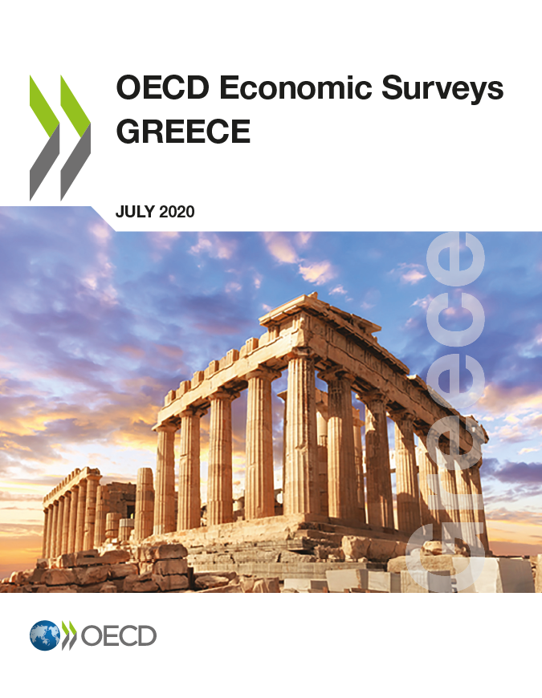

For more information
Disclaimers:
The statistical data for Israel are supplied by and under the responsibility of the relevant Israeli authorities. The use of such data by the OECD is without prejudice to the status of the Golan Heights, East Jerusalem and Israeli settlements in the West Bank under the terms of international law.
This document and any map included herein are without prejudice to the status of or sovereignty over any territory, to the delimitation of international frontiers and boundaries and to the name of any territory, city or area.
http://www.oecd.org/economy/greece-economic-snapshot/
Follow us on twitter:
OECD Economics
OECD

