Slide 1

European Tourism – Trends & Prospects
Quarterly Report 3/2019
Executive Summary
Notes:
1

Slide 2
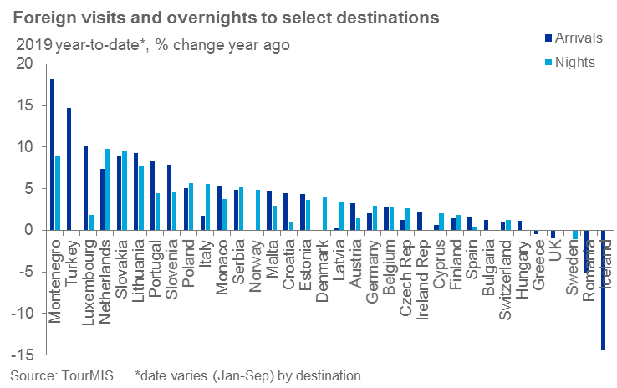
European tourism growth in 2019
European destinations exhibited a slow but steady expansion over the summer months.
According to the World Tourism Organization (UNWTO) international tourist arrivals to Europe were up 4% halfway through the year compared to the same period in 2018, despite a slowing global economic backdrop fraught with risks.
Recent data indicate a slower expansion in 2019 compared to the same period a year ago, with only one third of reporting destinations surpassing 2018 growth levels.

Slide 3
Intra-regional and long-haul source markets
Growth is mostly driven by intra-regional demand, with these origins expected to contribute nearly 75% of arrivals growth in 2019.
But long-haul source markets continue to make a significant contribution, particularly the US with the dollar up against many other currencies making travel to Europe more affordable.
Chinese appetite for European destinations remains strong amid a relative decline in the economy with virtually all reporting destinations seeing an increase in either Chinese arrivals or overnights (or both).

Slide 4
European air passenger traffic growth slowing
Average growth in global RPKs over the past three months was 4.1% (propped up by strong growth in June), well below the average rate of growth over the past 10 years of 6.1%. This reflects a general slowdown in global economic growth.
Year-to-date air passenger growth has slowed more rapidly in Europe than any other region, falling from 6.9% based on data to April to 5.4% based on data to August. This slowdown was particularly notable in July and August.

Slide 5
But European load factor continues to edge up
Load factors in Europe have been growing steadily for a number of years despite some very robust capacity growth. However, this has slowed in recent months, and the collapse of both Thomas Cook and Adria Airways in September will put further upward pressure on load factors in the near term.
Nonetheless, despite the significance of their collapse, we anticipate only a transient impact on capacity, with other airlines expected to fill the void in due course.
As was the case following the collapse of Monarch, we expect any capacity lost through the collapse of Thomas Cook and Adria Airways to return later in 2019 which should facilitate continued air passenger and arrivals growth in Europe.

Slide 6
European hotels are performing positively
Hotel accommodation performance in Europe was relatively positive across all regions based on year-to-date data to September. Occupancy rate growth has been relatively subdued, albeit against a backdrop of higher average daily rates (ADR) compared to the same period last year.
Occupancy rates grew 0.4% and ADR 1.9% compared to a year ago. This led to 2.3% growth in European RevPAR.
Despite concerns of slowing global demand, the fact that hoteliers have been able to grow rate and occupancy paints a positive picture.

Slide 7
Impacts of a ‘no deal’ Brexit on Travel & Tourism
A ‘no deal’ Brexit would affect tourism flows through a series of macroeconomic channels, sentiment impacts, and potential travel disruption.
A ‘no deal’ Brexit would cause a 7% drop in UK outbound trips in 2020 and an 8% drop in 2021, relative to baseline projections.
The impact from a ‘no deal’ Brexit would have a permanent downward effect on UK outbound travel volumes.
Spain is the most heavily impacted country in traveller volumes, and Ireland the most in per-centage terms.

Slide 8
Economic outlook
Last year global outbound travel demand grew around 5.6%, making 2018 the fastest growth year since the recession that was not a rebound from negative or weak growth in the previous year (e.g., 2010 and 2017). But 2019 will likely to be a slower year for global travel growth. The recent run of soft survey data suggests that an imminent rebound in global GDP growth is unlikely and that concerns about slowing growth and trade tensions may now be taking a toll on service sector activity. We still expect world GDP growth to slow into early next year; for both 2019 and 2020, growth is forecast to average 2.5%, the weakest since 2009.

